Slide 1
A balanced approach to testing
Brandon Corfman
May 6, 2021

Slide 2

Long-term JEL Objectives Plus Product Results
Rapid development
Rock-solid stability
Confidence in results from layered testing
Products
Layered testing
Evolutionary potential
Rapid deployment
Team agility
Continuous quality
Division of labor
JEL
Combined process
improvements

Slide 3
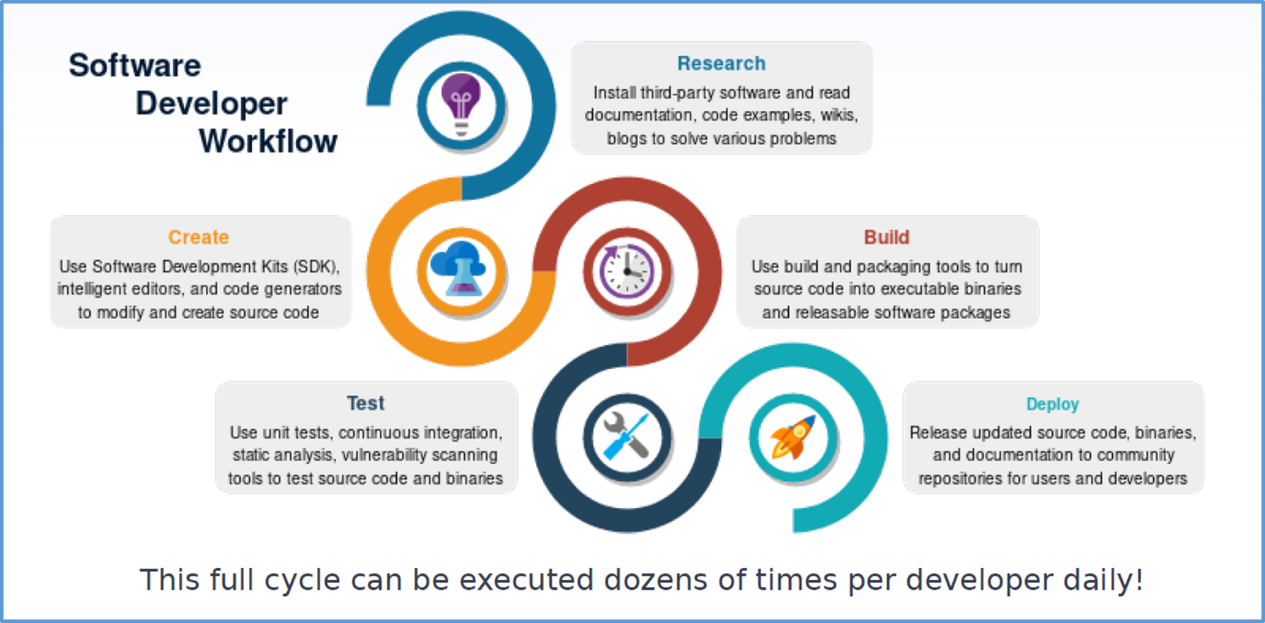
DevSecOps
What Do Software Developers Do?
Knowledge management is essential to every stage of DevSecOps and enables required security evaluation.
Security evaluation is integral to every stage of DevSecOps.
Notes:
How many applications across DAC does this affect.
How many sys-admins do we need?
Zero sum game.

Slide 4
Desire for balanced testing
Often typical test mix
System tests
What often happens:
Developers often do basic unit testing as they write single functions/methods.
System tests are often done after development is done, and all the code is hooked together.
Integration testing is largely ignored in favor of a large amount of system testing.
What works better:
Developers do smart unit testing as they write single functions, using partition/boundary checking.
Integration testing is introduced in stages, connecting two or more units and testing the interfaces between them.
System tests are done as the final integrations are made, testing a reduced set of prioritized use cases.
Integration tests?
Unit tests
Strategic, layered testing
System tests
Integration tests
Unit tests

Slide 5

Layered testing -- Learning by example
Elements involved:
GradingApp
Grader
passed
_
OnBtnDidIPass
class
get
_
letter
_
grade
A simple grading app that illustrates how layered testing methods work.
Using this grading app is easy: type in a final number grade for a class, click the “Did I pass?” button, and ideally the app will either tell you that 1) you passed the class, or 2) you failed the class.
Of course, users don’t always do the “right” thing!
But we can plan ahead …

Slide 6
Unit testing the Grader module
Elements involved:
Unit testing typically checks output of a single function or method.
Each function (unit) in the Grader module can be tested individually.
Easy to build lots of tests and troubleshoot/fix problems
Only success cases have been illustrated here, but invalid cases are equally important.
For instance, what happens when passed_class receives an invalid letter grade of ‘Z’?
What happens when get_letter_grade receives an invalid value of -101? 0? 5000?
Once we start checking for errors, when should we stop?
Smart checking of error conditions means we don’t need to cover every potential letter or number. This is called boundary or partition checking, and it reduces the number of needed test cases.

Slide 7
Integration testing
Elements involved:
Units are snapped together directly at this stage. (Think Lego bricks.)
The output of one unit is the input to another. Without some sort of connection, it isn’t an integration test.
Purpose of integration testing is to check data flow between interfaces. Yes, it’s needed.
Complete interface/parameter coverage
Precise error/exception trapping or propagation
Correct external library calls
As many units as needed can be integrated during this testing phase. It’s better to build up to it in stages though.
In this diagram, we can see that certain inputs we tested at the unit level are difficult or impossible to test at the integration level.
For instance, we cannot test passed_class with an invalid letter grade input using an integration test. (Invalid letter grades aren’t allowed.)
Once components are integrated, it may be much more difficult to pass an invalid input.
We must rely on proper unit testing first to consider all categories of input errors.
Notes:
Bullet 2 is important. Every dev has probably done it – you’ve duplicated portions of your app code to connect a series of code and function calls together and called it an integration test. But, unit tests + glue code are either Fancy Unit Tests or just system tests. Not integration tests. The need for glue code indicates that your interfaces don’t match and need 1) additional design work, or 2) wrapping to hide data type translations.
Bullet 3 means that although inputs are needed to drive the test and outputs are checked to verify that the test ran, the real purpose of the test is to make sure that the unit interfaces match up correctly. This includes checking whether inputs/outputs are coerced to invalid types (e.g., floating point values are switched to integers; 32-bit values are switched to 16-bit values; more derived types are switched to less derived types). The importance of this is underscored by the Ariane 5 rocket explosion due to a type conversion error – a direct result of missing integration tests.

Slide 8
System testing
As more components or units are integrated, subsystem- or system-level integration is achieved.
Functionality is evaluated with system tests.
Glue code is often (99%) involved.
Realistically, not all code is composed into functions. Any code in-between function or method calls is glue code.
Not all glue code is bad design, but it usually is. Glue code is something to minimize, especially if it starts showing up in your test suite.
Glue code can mean that data values could get changed unexpectedly (and transparently) between functions.
Data validation often happens at the system level.
Here we have a validate_data function that intercepts bad scores. Good move.
However, what if someone wants to use get_letter_grade inside another place in the code, and we haven’t validated those inputs first as we did here?
We can’t solely rely on system tests to checks all errors in our underlying functions.
We can’t assume data validation in one spot maintains data integrity everywhere.

Slide 9

Balanced testing
A program is only as strong or reliable as its basic components.
Good test coverage at the unit/integration level, and good functionality testing at the system level is defense in depth.
System tests don’t normally touch all of the code paths required.
GUI data validation is a good idea, just not in isolation.
Often it’s assumed that data validation removes the need for error handling in other functions/modules. This is not the case.
Boundary/partition testing at the unit/integration levels provides the needed test coverage.
Covers success, failure and error cases
Building upon good unit and integration tests means that only representative categories of system tests need to be generated ... e.g., dozens, not hundreds.
Notes:
Defense in depth is a term used in information security: overlapping systems designed to provide security even if one of them fails. This type of additional assurance also applies to balanced and layered testing.

Slide 10
Test coverage
Test coverage needs focus
JEL will communicate test coverage as primary metric in all test reports. Methods of reporting will look slightly different for each test level, and so would require some collaboration.
Capability team should communicate desired strength of test coverage and testing priorities for each feature. Common use cases for methodology should have more emphasis than uncommon ones.
Examining test coverage with current WinBlast configuration
Although we can report the WinBlast plugin test coverage since we have the source code, many of the underlying libraries are in binary form only.
Can we also get test coverage reports from the dependent modules?

Slide 11
Conclusion
Capability team needs to focus on
Evidence of proper design and testing of all modules, if possible.
Test case design at each design iteration, in conjunction with WinBlast developers and JEL team.
We want to concentrate on including missed tests or eliminating redundant cases at each layer to achieve a balanced testing approach.
Unit
Integration
System
Good team decisions on the number of boundary or partition test cases and measuring code coverage will help improve our priorities and progress.

Slide 12
To-do list for Cap Team
Create WinBlast-EF error handling strategy
If correct error handling is not possible in the WinBlast EF plugin alone, then we may need to propagate the same strategy to WinBlast itself
Set a goal for test coverage percentage
For large projects, 50-60% coverage is reasonable
Our goal can evolve as testing proceeds
Design integration test suite
Good validation test design requires SMEs to define realistic input scenarios
Prioritize important JWS use cases that will feed into their system tests

Slide 13
END

Slide 14
Partition checking
Partitions are sets of values that are treated in the same way by the system.
Going back to our get_letter_grade example, input partitions are
grade >= 0 and grade < 60, which result in a letter grade of “F”.
grade >= 60 and grade < 70, which result in a letter grade of “D”.
grade >= 70 and grade < 80, which result in a letter grade of “C”.
grade >= 80 and grade < 90, which result in a letter grade of “B”.
grade >= 90 and grade <= 100, which result in a letter grade of “A”.
Values from valid partitions should be processed correctly.
Values from invalid partitions should trigger exceptions or error messages.
Partitions eliminate the need to create test cases for all possible combinations, reducing them to a much smaller set.
When selecting partitions:
Correct selection will lead to effective and efficient testing.
Incorrect selection will lead to missed or redundant test cases.

Slide 15
Boundary checking
Compliments partition checking.
Checks values at range boundaries, since boundaries are often problematic.
Going back to our get_letter_grade partitions as an example, where should we test boundaries?
-1
0
5
60
65
70
75
80
85
90
95
100
101
F
D
C
B
A
Invalid
Valid
Invalid
Practically speaking, we can check -1, 0, 100, 101 to hit valid and invalid values, but ...
... the decision to prioritize 4 to 13+ test cases depends on code complexity, confidence in software development processes, and the critical nature of the system.
<< BACK

Slide 16
Background …
What’s test coverage?
Test coverage is the percentage of code branches in each subroutine that have been tested.
Coverage information is highly valuable to an approval authority who needs to know if all the parts of the code that will be approved have been exercised.
100% test coverage is ideal but often unachievable due to resource limitations.
Capability team needs to decide what percentage of coverage they will reasonably achieve.
A knowledgeable human in the loop is needed to fully interpret test coverage.
As one example, a model may have one code path to read a file and have a test that calls that code. In this case, a test tool would report 100% code coverage.
However, if the file could not be opened, the model is missing code that would handle the error. Adding one new path for error handling will improve this code, but without a new test written for this case, the improved code will show only 50% code coverage.
In the above example, the revised 50% code coverage is better than the original 100% coverage because the model is doing a better job at error handling.

Slide 17
Background …
Consistent and correct error handling
Both the capability team and the JEL team must know a model’s error handling approach and evaluate whether it’s being followed in order to properly judge a code coverage metric.
For instance, if the model encounters a problem during its execution, does it:
Issue a warning?
Fail immediately?
Rollback to a previous point?
Supply reasonable fallback data?
Ask the user for additional input?
Choose an alternative execution path?
The Capability Team must define and document the error handling approach.
The developers must code and test the approach.
The Capability Team will review test reports to see that the error handling approach is consistent and correct.

Slide 18
Strength of unit test coverage
Consider the following code snippet:
1: if (a > b) or (c > d):
2: x = x + 1
Every statement (100% statement coverage) can be exercised with one test case.
a = 1 and b = 0.
Every decision (100% decision coverage) can be exercised with two test cases.
(a=1 and b=0) or (c=3 and d=2). True
(a=0 and b=1) or (c=5 and d=5). False
Every condition (100% condition coverage) can be exercised with four test cases.
a > b | c > d | Execute statement 2?
True | True | Yes
True | False | Yes
False | True | Yes
False | False | No

Slide 19
Strength of integration test coverage
Recall integration tests check data flow between interfaces.
The obvious tests:
Each unit passes the right data to the next.
Errors in one unit do not blow up the next.
All the different ways/modes in which integrated units will be exercised.
Calling external libraries.
The not-so-obvious (developer-level) tests:
Converting implicitly between data types (e.g., 32-bit to 16-bit). Can silently introduce data errors.
Casting between data types (and losing associated type information) at runtime. Can blow up later when the program doesn’t know what data it’s dealing with.
Notes:
Types of implicit type conversions:
Floating point -> integer (loss of precision)
Unsigned to signed (loss of information)
Signed to unsigned (possible memory corruption)
32-bit -> 16-bit (loss of precision)
16-bit -> 32-bit (possible memory corruption).
Types of class hierarchy issues:
Derived classes with redefined methods
Subclasses with different behavior
Casting away class information

Slide 20
Strength of system test coverage
Recall system tests check functionality.
As with partitioning test cases, it is important to consider which sets of inputs are equivalent in terms of functionality.
For example, desired system test coverage at one recent CDR identified 28 representative weapons and 42+ representative targets. Can we answer:
Are these weapons or targets equivalent in terms of input data?
Are they equivalent in terms of the model paths/modes they exercise?
Do the results look substantially similar? (i.e., output equivalence)
When selecting system cases -
Correct selection will lead to effective and efficient testing.
Incorrect selection will lead to missed or redundant test cases.
Important pairings (most often selected by the user) should take priority.
<< BACK

Slide 21
Terms and definitions
Unit testing – checks an individual software component to ensure that expected output is obtained.
Integration testing – checks two or more software components to ensure that their interfaces are correct.
System testing – checks integrated software components to ensure that proper functionality or behavior is obtained.
Acceptance testing – once a system is built, a user representative tests the system to make sure their specific requirements have been met.
Regression testing – re-testing prior functionality to make sure it still behaves the same way after new features are added.
Smoke testing – testing key features quickly to determine if things are broken.
Automated testing – scripting tests to run without human input.
Manual testing – tests conducted by a human.
COVERED
NOT COVERED
Notes:
Those types of testing that aren’t covered are still important – it’s just they are already being done by the JPC or others.

